Slide 1
CONCLUSIONS

Slide 2
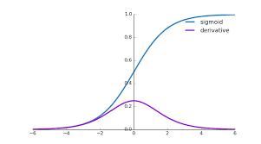
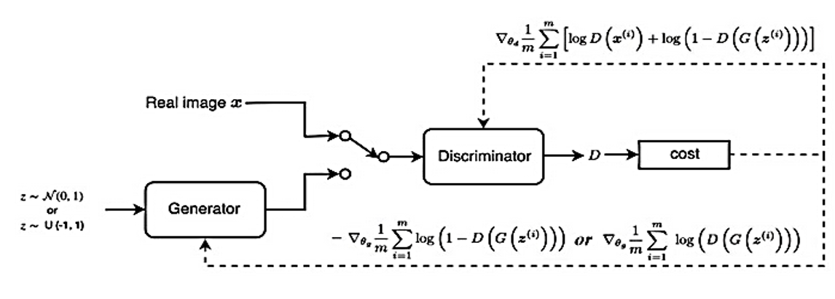
RECAP OF GANs
Problem of Vanishing Gradients
As hidden layers increase the partial derivative terms starts becoming smaller and smaller.
The discriminator doesn't provide enough information for the generator to make progress.
Weak Classifier
Weak Generator
https://medium.com/analytics-vidhya/the-problems-of-generative-adversarial-networks-gans-3d887efa578e

Slide 3
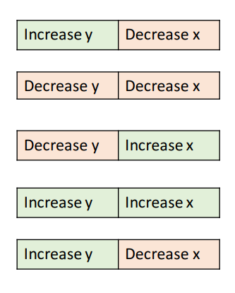
RECAP OF GANs
Problem of Non-Convergence
GANs involve two players
Discriminator is trying to maximize its reward.
Generator is trying to minimize Discriminator’s reward.
SGD was not designed to find the Nash equilibrium of a game.
Problem: We might not converge to the Nash equilibrium at all

Slide 4
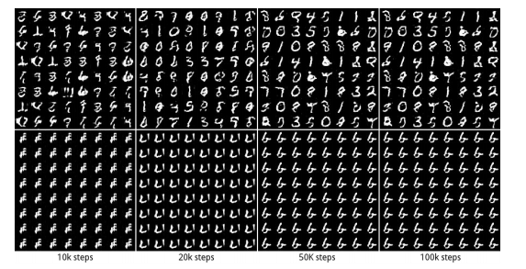
RECAP OF GANs
Problem of Mode Collapse
Generated Distribution
Generated images converge to x^ that fool D the most -- most realistic from the D perspective
Discriminator gets stuck in a local minimum and doesn't find the best strategy.
Generator keeps producing small set of modes or output types.
No Mode Collapse
Mode Collapse
Data Distribution

Slide 5
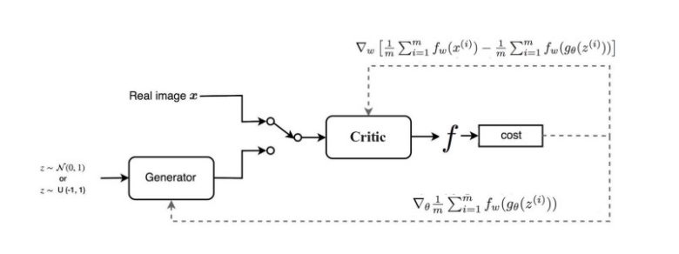
RECAP OF GANS
Some Solutions - WGAN
The major difference is due to the cost function:
Discriminator does not actually classify instances rather outputs a number.
Discriminator training just tries to make the output bigger for real instances than for fake instances => Called a “ critic” than a discriminator.
If the discriminator gets stuck in local minima, it learns to reject the outputs that the generator stabilizes on. So the generator must try something new.
Helps avoid problems with vanishing gradients & model collapse.

Slide 6
RECAP OF GANs
Adversarial Attacks
White – Box attacks :
Attackers have access to Model architecture, weights.
Calculate the perturbation δ based on loss function.
Attackers push the perturbed image to be misclassified to a specific target class.
Black - Box attacks :
Attackers do not have access to the classifier or defense parameters.
Trains a substitute model using a very small dataset augmented by synthetic images labeled by querying the classifier.
Examples that fool the substitute end up being misclassified by the targeted classifier.
Input Data
+
Network
Misclassified output
Perturbation

Slide 7
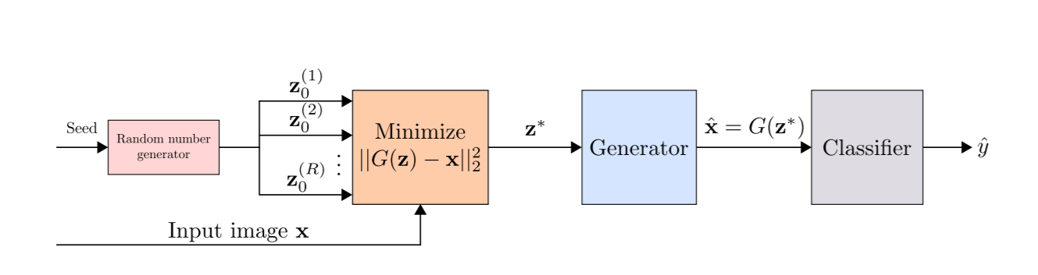
DEFENCE GAN
Pipelining a GAN with Anomaly Detection Classifier
WGAN trained on legitimate (un-perturbed) training samples to “denoise” adversarial examples.
At test time, prior to feeding an image x to the classifier, x is projected onto the range of the generator by minimizing the reconstruction error ||G(z) − x||²₂ and produce output to a given image which does not contain the adversarial changes.
The resulting reconstruction G(z) is then given to the classifier. Results in a substantial reduction of any potential adversarial noise.
https://arxiv.org/pdf/1805.06605.pdf

Slide 8
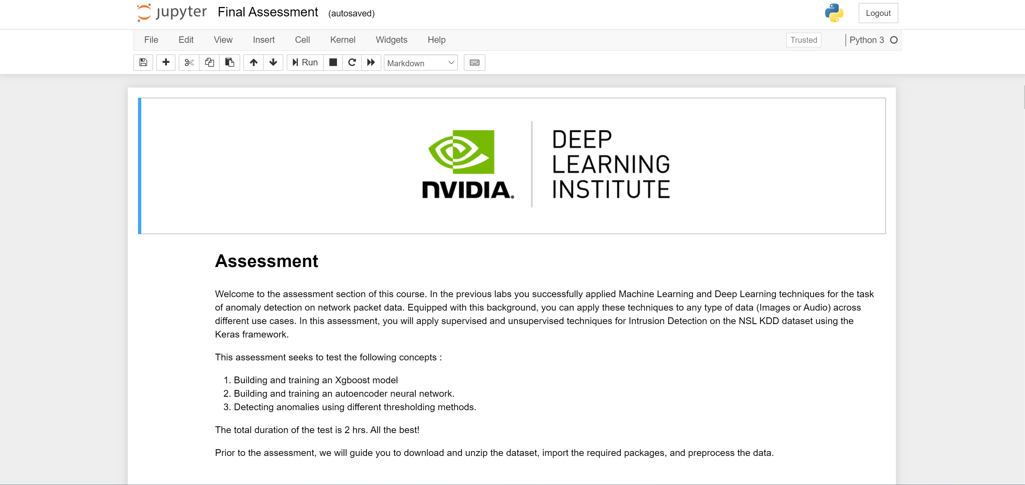
All the Best!
Assessment

Slide 9
Thanks!

